Slide 1





LEAF: Navigating Concept Drift in Cellular Networks
Shinan Liu, Francesco Bronzino, Paul Schmitt, Arjun Nitin Bhagoji, Nick Feamster, Hector Garcia Crespo, Timothy Coyle, Brian Ward
Notes:
Hi everyone, thank you so much for coming today! I’m happy to present you _title_. This is a measurement and system work, but it indeed can be applied to a lot of security applications. LEAF is helping Verizon to combat concept drift. And if you are using ML in dynamic environments, I believe LEAF is going to help you as well.

Slide 2

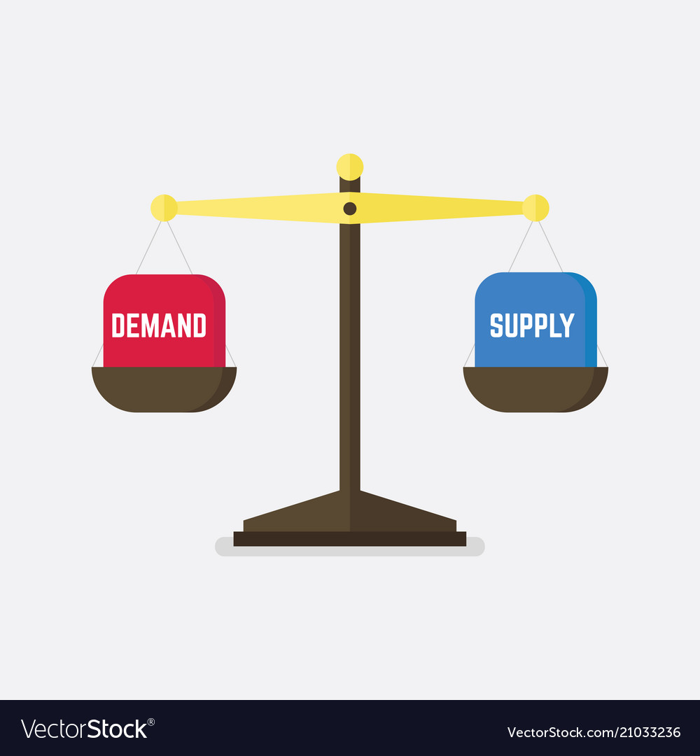

Machine learning models for cellular networks are being deployed
Anomaly detection
Performance inference
Demand forecasting
Notes:
Today, ML models for cellular networks, or networking in general, are being deployed.
Applications like anomaly detection, performance prediction, and demand forecasting all require the great capacities of ML models.
A fairytale version of this story is that, after models being deployed, they serve their purposes happily ever after, without any compromise on the promised performance.

Slide 3
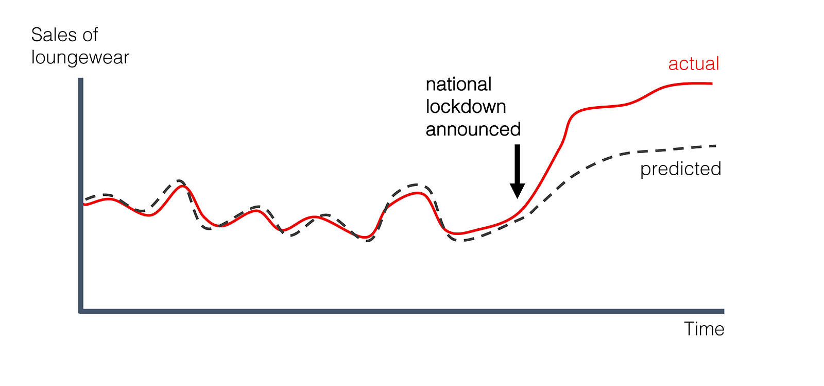
What is concept drift?
Demand
Notes:
Let’s look at an example, say we have a model to predict a Key Performance indicator (KPI) trained at the beginning and test it on a daily basis.
The model performs good at the beginning, but when a national lockdown is announced, it faces a disagreement between the actual and predicted values, which is concept drift.
It means that the statistical properties of the target variable, which the model is trying to predict, change over time

Slide 4
But is deployment the end of the story?
After deployment, models for networking often face:
Sudden, drastic changes
The installations of new equipment, a software upgrade, deployment of 5G, COVID-19 pandemic …
Periodic changes
Seasonality, weekly patterns …
=> As a result, model performances degrade over time:
concept drift
Notes:
However, is deployment the end of the story?
In reality, models for networking often face two sources of changes, .
The first source is sudden and drastic changes. For example, the installation of new equipment, a software upgrade, deployment of 5G, and COVID-19 pandemic. They all change traffic patterns or demands, which can cause models to suddenly become inaccurate.
The second source is periodic changes, although many models take seasonality or weekly patterns into considerations, over time, the amplitudes of these patterns essentially changed.
As a result, model performances degrade over time
We call this phenomenon as concept drift

Slide 5
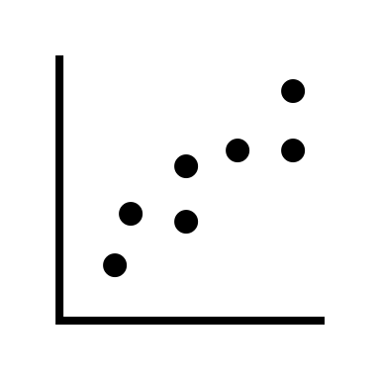


We seek the answers to three questions
What are the characteristics of concept drift in cellular networks?
How do we detect, explain, and mitigate concept drift?
How effective are the end-to-end mitigation schemes?
Notes:
We seek the answers to 3 questions in this work.

Slide 6
We investigate over four years of data from a US metropolitan area
Collection period |  | Jan. 1st 2018 – Mar 28th 2022
Identifiers |  | eNodeB ID & Timestamp
Number of KPIs |  | 224
Groups of KPIs |  | Resource utilization Network performance User experience
Number of eNBs |  | 412 persistent 898 total
Number of Logs |  | 699,381 1,084,837

Slide 7
The goal of our modeling is to predict network capacity demands in 180 days.
Task: use all KPIs (features) today to predict one KPI of interest (target) in 180 days.
Default settings:
Training set: 90-day historical data from all eNodeBs before July 1st, 2018 to forecast a KPI of interest starting from December 28th, 2018.
Testing set: the following data subset by date.
4 families of models: CatBoost, Extra Trees, K-Neighbors, LSTM
Error metric: Normalized Root Mean Squared Error (NRMSE).
Notes:
We focus our study of concept drift in the context of network capacity forecasting.
Capacity forecasting is an important problem for operators as it guides infrastructure configuration, management, and augmentation.
Why 180 days? When operators try to initiate a capacity augmentation, it's essentially a decision that worth millions of dollars. 180 days to discuss, evaluate, and execute the decision.
This 180-day gap also makes it harder to mitigate the drift.
Gradient boosting: LightGBM, LightGBM Large, LightGBM XT, CatBoost, and XGBoost
Bagging: Random Forest and Extra Trees
Distance-based: Kneighbors
RNN: LSTM
To explore the performance of different widely-adopted regression and time-series prediction techniques, we select 4 different families of models. They are _xxx_.
All models either incorporate temporal features (\eg, time stamps, day of the week, month, year), or are time-series models (LSTM).
We create a single model capable of forecasting values for each individual base station.
We measure the Normalized root mean squared errors by date. We make normalization because we want to better understand drift across KPIs whose natural operating value ranges are different.
we also test the performance of regression by the other metrics including coefficient of determination (i.e., 𝑅2), mean absolute percentage error, mean absolute error, explained variance score, Pearson correlation, mean squared error, and median absolute error. We omit these metrics for brevity. We observe that all phenomena we describe in the paper using NRMSE also hold for these metrics.

Slide 8
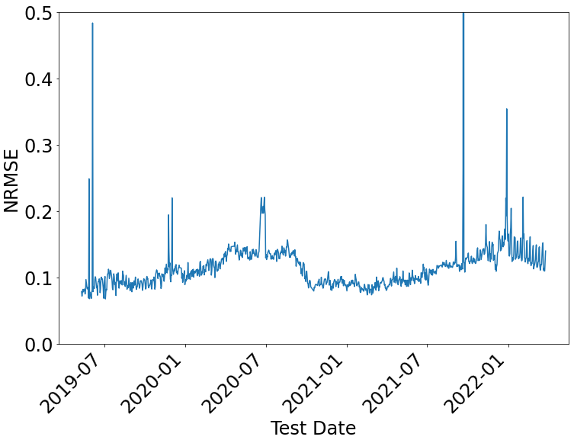
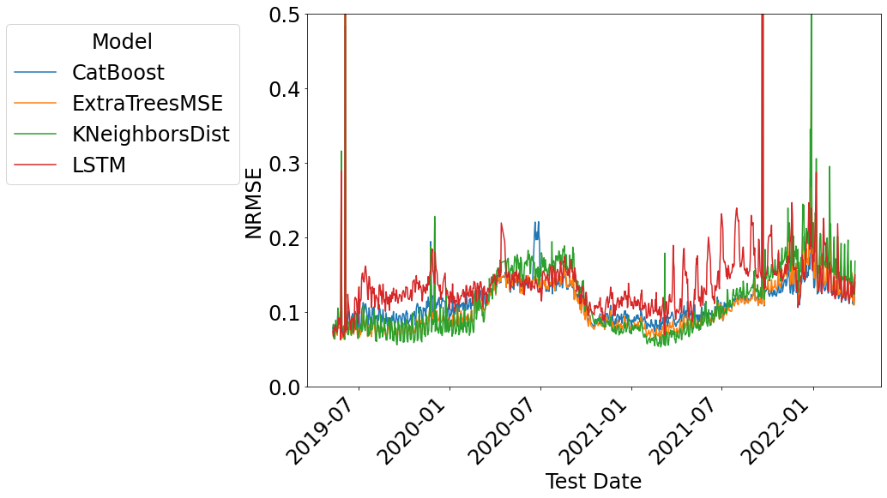
Drifts appears consistently across different models
Notes:
The first insight is that individual KPI predictions drift consistently across different models.
NRMSE time series plots of each KPIs. X-axis test date, y-axis NRMSE, 4 models are presented, and it has an inset figure of a 3 week pattern.
As mentioned earlier, we use four different models to check for concept drift over time, while predicting KPIs 180 days in the future. We find that all models exhibit the same pattern.
For example, between March and October 2020, all models exhibit a drastic rise in NRMSE due to the COVID-19 pandemic.
Early 2022. gradual drift
So they are drifting at the same pace
Given our observations that CatBoost performs well when instances of drift
Chances are we can use a holistic framework to mitigate as many frameworks as possible

Slide 9
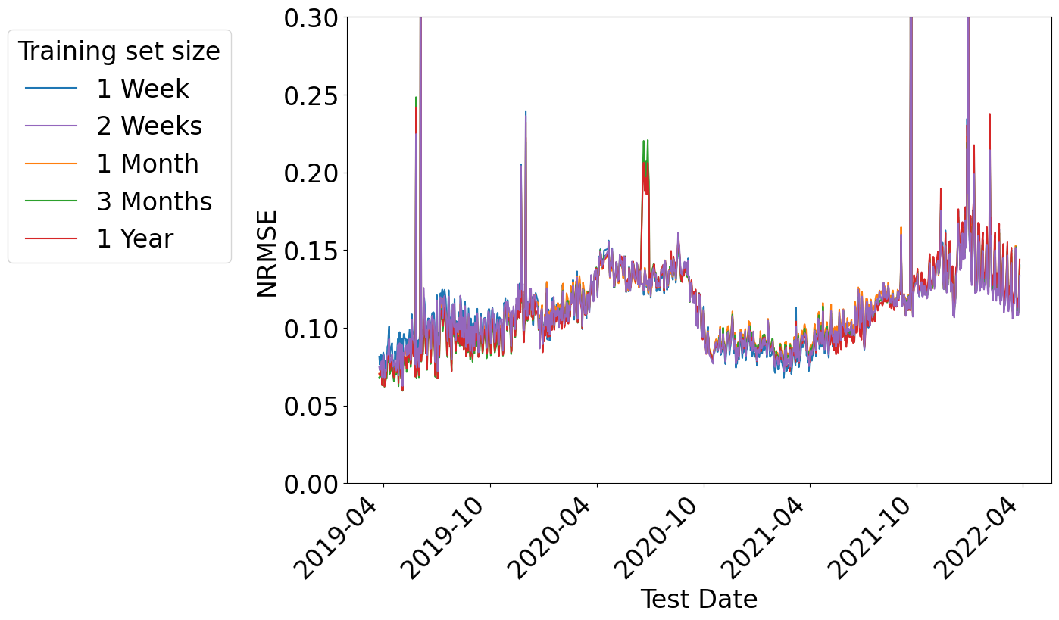
Drift appears independently of training size
Notes:
To investigate how parameters of a model could impact concept drift, we evaluate the impact of varying the training set size and periods.
We vary the training window in figure (a), legend is training set size, which means how many days of the data before July 1st 2018 are taken into consideration for the training.
Still, they drift at the same pace.
We see that the model effectiveness of two weeks performs very similarly to that of one year, while model training time on two weeks is 18x more efficient than one year. So we take 2-week as the default training set size for the rest of the analysis.
Since we are testing the long-term effectiveness of our model, another concern is that whether the choice of the training period would affect the drift. In this experiment, we train on a number of different 14 day windows of historical data from all eNodeBs.
In Figure b, the legend shows which 14 days are selected for training: 14 days of data before the date. For each training set, the model is tested daily in the future using a 180 day forecast. Figure 2b also suggests that, no matter which training period, all NRMSE values drift simultaneously at similar timestamps. Our experiment also suggests that models trained on more recent time periods do not necessarily result in better model performance. For example, during training, the green line is worse than the blue line. This means that the model is trained on a rather abnormal period—winter holiday before the beginning of the COVID-19 lockdowns. On the contrary, model trained on older data (blue line in Figure 2b) preserves the performance better during COVID-19 lock downs. This observation opens new possibilities for future research in exploring the best strategies for adapting to drift.
To summarize, concept drift is a universal phenomenon in cellular network forecasting, regardless of model, training set size and training set period.

Slide 10
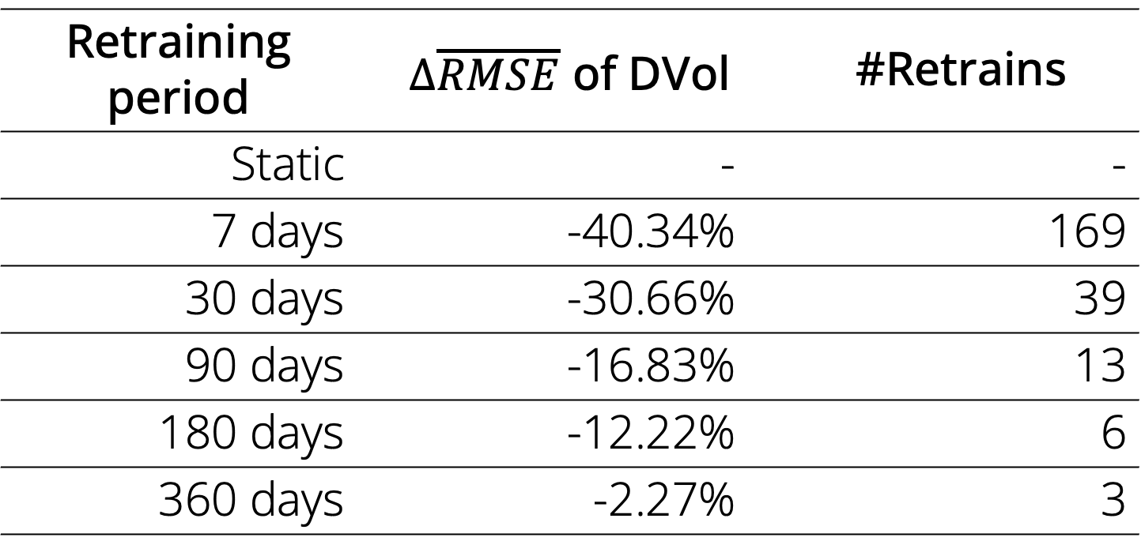
Naïve retraining is either ineffective, or effective but very costly
Retraining period |  | $∆\overline{RMSE}$ of DVol |  | #Retrains
Static |  | - |  | -
7 days |  | -40.34% |  | 169
30 days |  | -30.66% |  | 39
90 days |  | -16.83% |  | 13
180 days |  | -12.22% |  | 6
360 days |  | -2.27% |  | 3
Notes:
Before I dive into our system, let me first show the defacto approach to combat drift.
In operational networks, a common and most effective approach to counteract potential concept drift is to retrain models regularly. Retraining using the most recent data is often considered an effective way to deal with it.
To understand whether this approach is indeed effective and further analysis on concept drift is necessary, we retrain a number of different models regularly by altering the frequency of retraining. Still we are using CatBoost and the best parameters we found in the previous experiments.
To our surprise—and counter to conventional practice—we find that naïvely retraining regularly is not an optimal approach to adapt to concept drift.
Compared to a static model, Naïve retraining is either ineffective, or effective but very costly, requiring a large amount of retrains.
For most targets, i.e., DVol, REst, and DTP, the more frequently a model retrains, the better results we obtain. Further, we observe that this trend breaks for bursty KPIs such as CDR (32.59% of error increased). In this case, frequent retraining can even adversely affect model performances.
Unfortunately, while a 7 days retraining period can mitigate a large portion of errors, frequent retrains can become very costly and require 12x more retrains than a 90 days retraining period. Overall, we conclude that naïve retraining is impractical because it normally works all at high retraining frequencies and requires specific tests across different KPIs to at best fine-tune its performance. Both are challenging when run at scale in operational networks.
The above results demonstrate that naïvely retraining models is not an optimal solution to combat concept drift, motivating the rest of this paper.

Slide 11
Takeaways of concept drift characterization
Concept drift is a universal phenomenon regardless of
Model family
Training set size
Target KPIs
Naïve retraining is either ineffective or costly
Can we do better?
Notes:
Detection, tested multiple
Do we need slides for all sections?
Guide our design of the mitigation framework.

Slide 12
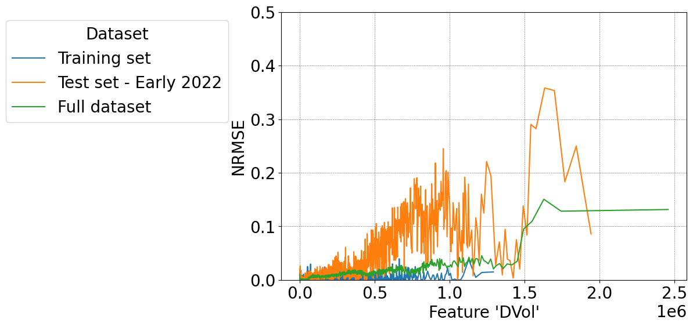
Intuition
Undertraining
Region

Slide 13
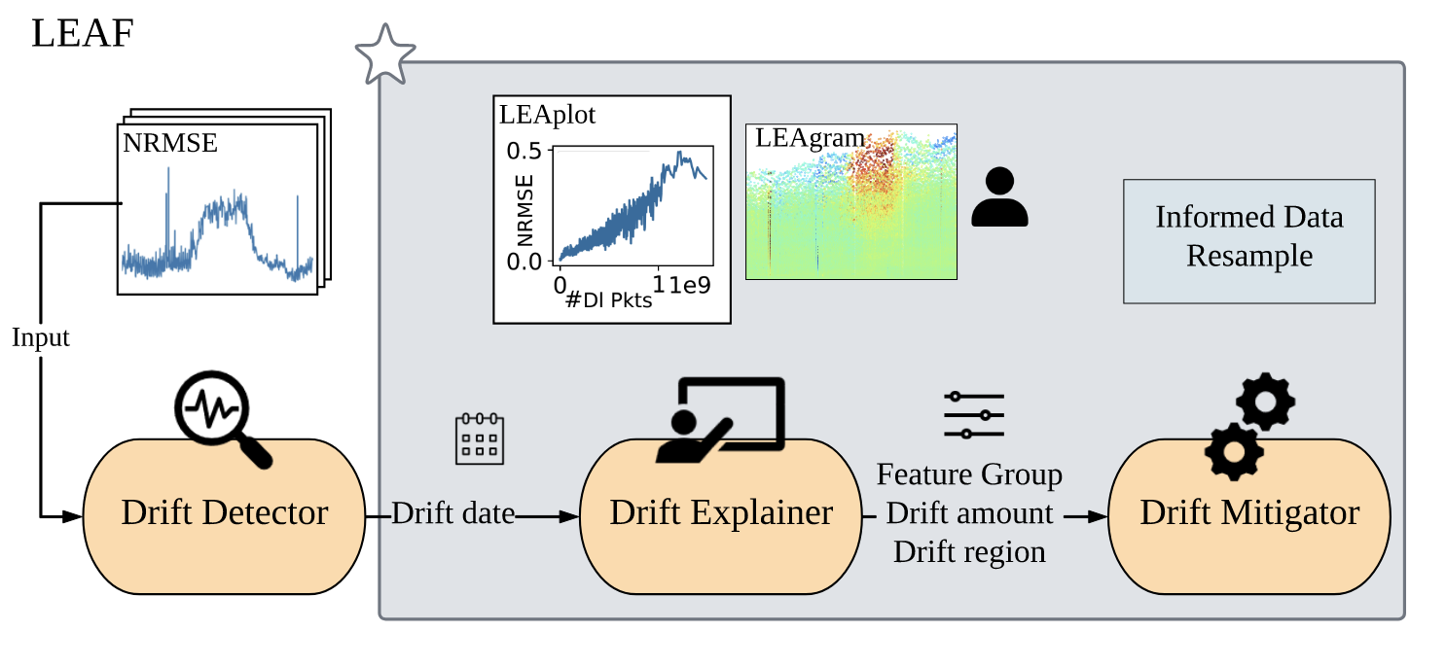
LEAF: Local Error Approximation of Features
Notes:
Based on these design principles. We introduce LEAF, Local Error Approximation of Features.
LEAF is a pipeline of three sequential com- ponents: 1) a drift detector; 2) a set of tools to explain drift for feature groups and 3) a drift mitigator.
Detector takes in NRMSE time series, and output the drift date.
Although drift detection is critical, it is not the main focus of this work. as there is significant prior work on drift detection. The detector applies the well-known Kolmogorov-Smirnov Windowing (KSWIN) method on the time-series to identify a change in distribution of the output error, providing asignal on whether drift is occurring.
The explainer finds the most representative features and uses LEAplot and LEAgram to characterize the drift. These tools provide insights on where drift is most severe for each feature group, and offer guidance for model compensation.
Finally, the mitigator is automatically triggered to provide effectiveness metrics for several candidate mitigation approaches. It is based on the error distributions provided by the explainer and use resample, or augmentation or ensemble to mitigate. For example,
Since the detector is using existing methods and the mitigation is largely dependent on the explanation, we focus on the drift explainer and will come back to the end-to-end pipeline later.

Slide 14
LEAF explainer and local error decomposition
Idea: local errors may vary in different value ranges of a given feature or correlated feature set.
Goal: determine the extent of error present in specific regions of the feature space.
Find most representative features.
Determine the error distribution of a feature.
Understand the temporal changes of error distributions.

Slide 15
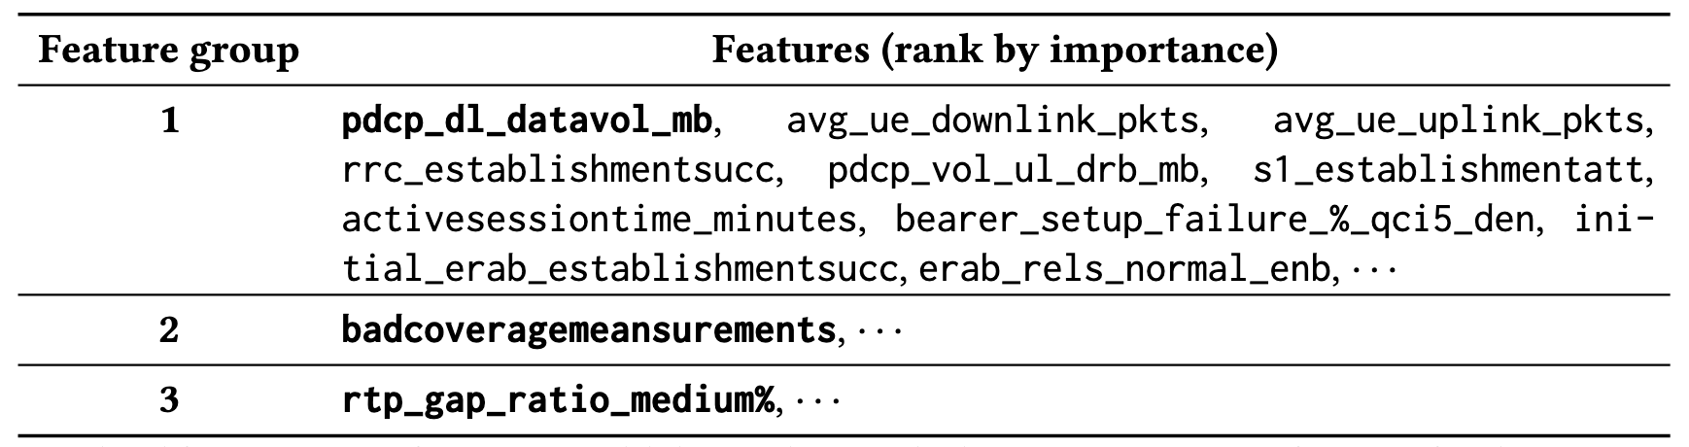
LEAF explains which features are the most representative ones.
Goal: find the features that provide the most valuable error approximations by ranking, grouping, and representing.
Case study: use CatBoost to predict Downlink Volume.
Notes:
Local Error Approximation of Features. But there are many features, find the features that provide the most valuable error approximations.
Step 1: Rank features by permutation-based feature importance
Step 2: Group correlated features
Grouping stops when the feature has no importance value
Step 3: Choose the most representative (highest importance score) feature from each group

Slide 16
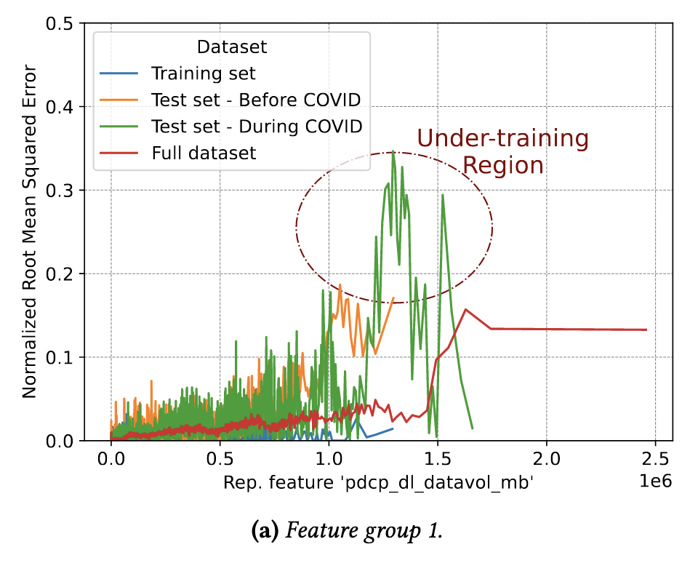
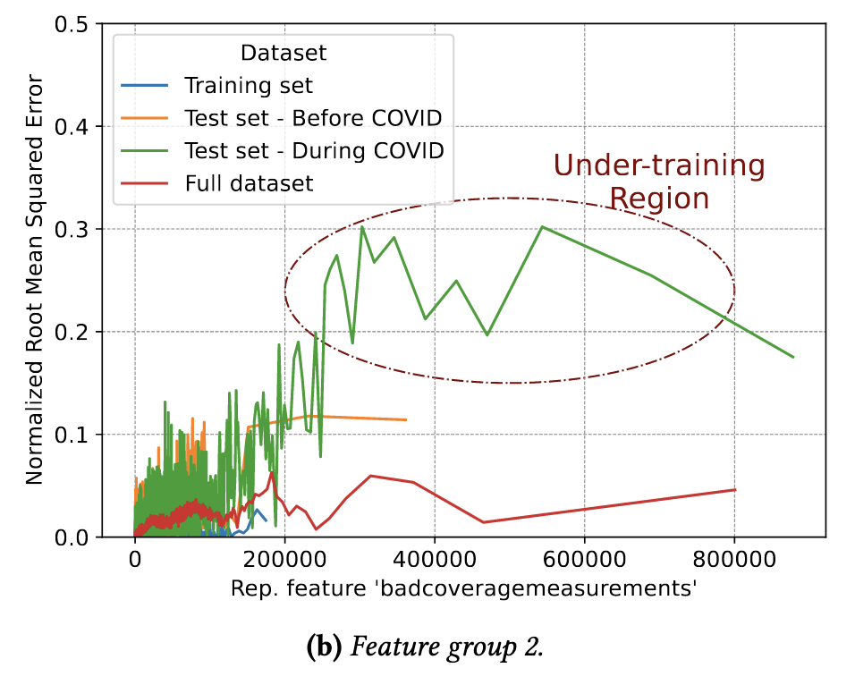
LEAplot explains drift amounts and regions of a black box model.
Goal: determine the extent of error present in specific regions of the feature space.
Notes:
We use LEAplot to help visualize the local error components and compare them across different data subsets.
Input and output of a any black-box models
X-axis, y-axis, 4 subsets
For each data subset, we then group samples based on the value of the important feature into 𝑁 bins. And compute NRMSE within the bin.
It makes intuitive sense that the error of training set is low across feature values.
And during COVID.
Local concept decomposition
When its value is below 0.75e9, the errors in “During COVID” test set are more than 10x those of training set and nearly 1.5x of those in the “Before COVID”
For the features within a feature group, because they are correlated, the LEAPlot is quite similar in terms of error distribution. So we use one to represent them the same feature group.

Slide 17
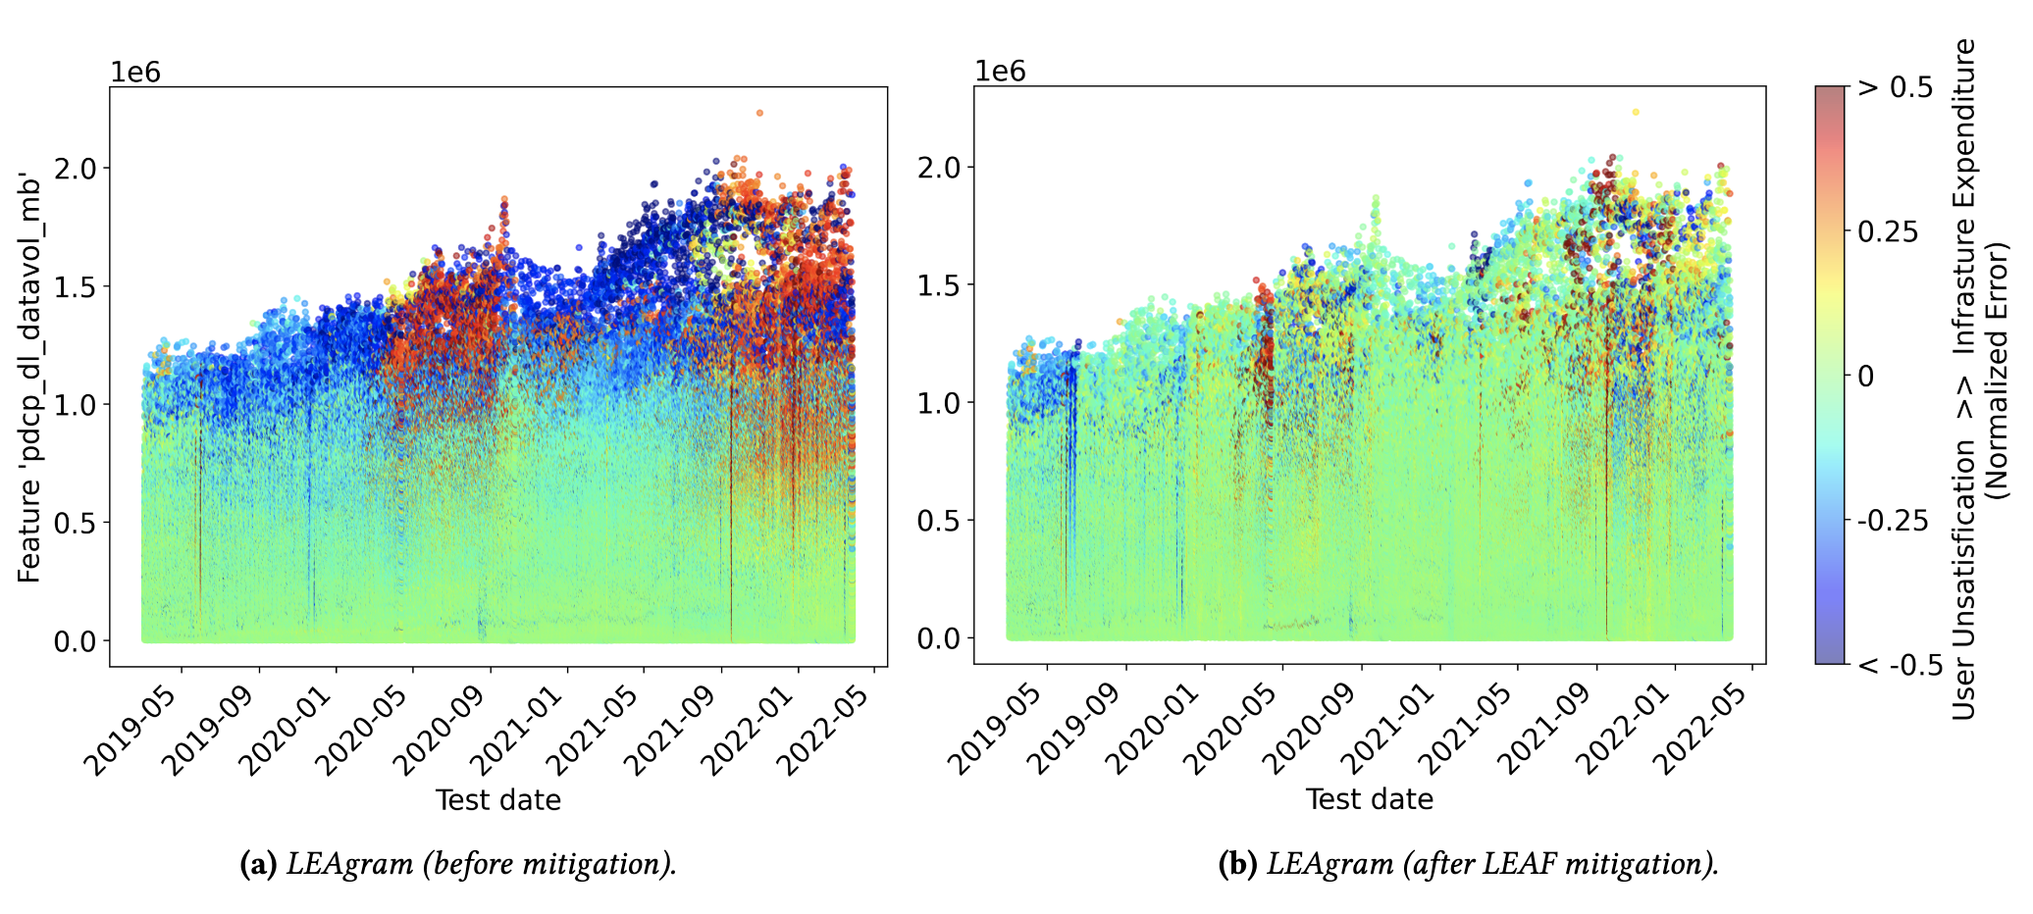
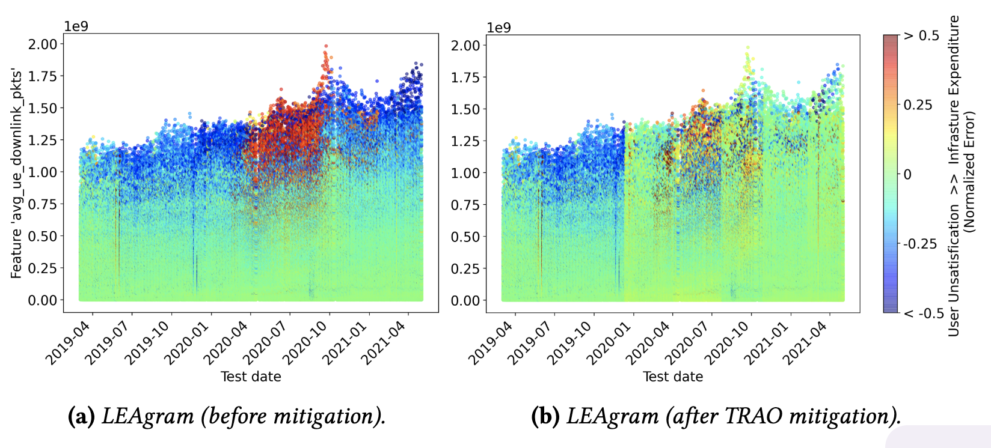
LEAgram visualizes temporal changes of errors.
Notes:
Why do we want both LEAplot and LEAgram?
Use
LEAgram augments LEAplot by incorporating temporal information. It divides the test set by time interval (e.g., date) and assigns samples from those divided datasets into 𝑁 bins, based on the value of the most important feature with regard to drift.
X-axis, y-axis
Red means overestimation, leads to higher cost on the infrastructure
Blue means underestimation, leads to user unsatisfaction
Below 0.75, Model perform quite good. Achieving nearly 0 errors.
From March 15, 2020 to November 1, 2020, when the value of feature avg_ue_- downlink_pkts is above 0.75e9, large positive errors occur, implying overestimation. If the operator were to base deci- sions on the output of this model, they may unnecessarily add to infrastructure. The model also has negative prediction errors above a value of 1e9 for feature avg_ue_downlink_- pkts, which could lead to user dissatisfaction.

Slide 18
Putting it together: informed mitigations
Idea: compensate the feature value range that has the largest errors by forgetting and over-sampling.
Notes:
Need more work

Slide 19
Evaluation targets: end-to-end mitigation schemes.
Baselines
Static: doing nothing
Naïve: Naïve retraining
Triggered: Triggered retraining
Our approach
LEAF: Triggered + Explanation-based + Data-centric retraining

Slide 20
LEAgram before and after mitigation
Feature ‘DVol’
Normalized Error
Notes:
From the LEAgram, the mitigation is even more pronounced.
Red and blue parts become green after mitigation, which means the model is now good at predicting all ranges of values.

Slide 21
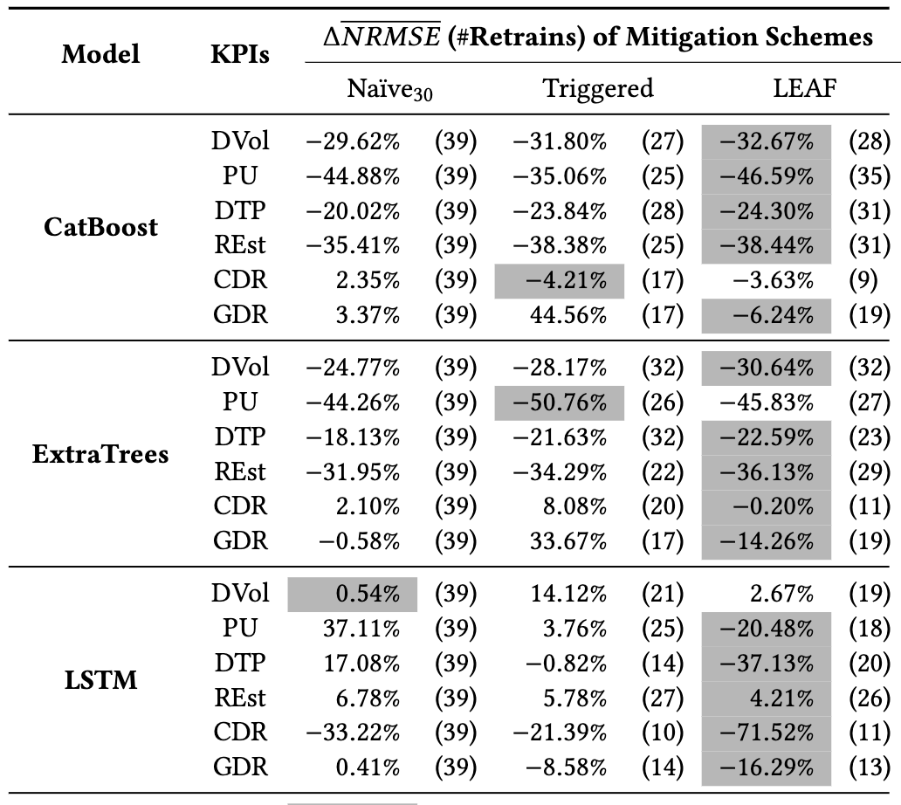
Mitigation effectiveness of LEAF vs. other baselines
LEAF scheme outperforms each baseline
across KPIs
and models
Notes:
Note that for the cost
Plus, our method is constantly better than static, while the other baselines still suffer from worsen experience.
The KPI for which naive retraining works best across models is DTP (Downlink Throughput) due to its low coefficient of variance and lack of abrupt drift (Figure 1b)
KPIs with higher coefficients of variance (CDR, PU) are harder to mitigate.

Slide 22
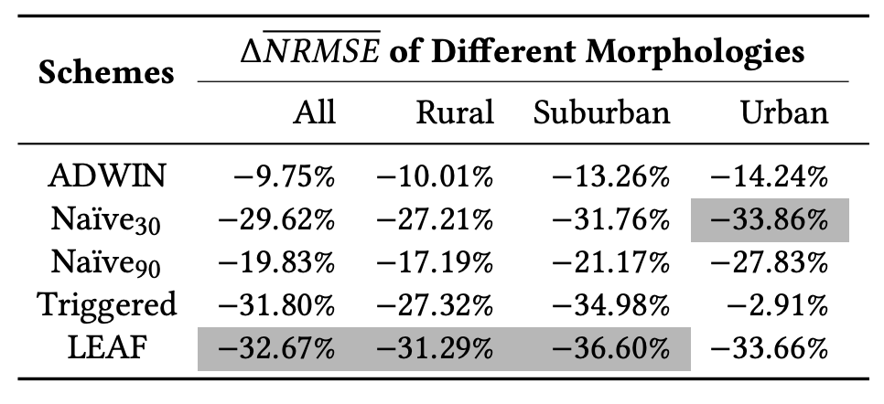
Mitigation effectiveness across morphologies.
Notes:
By adding the number of representative features, the effectiveness can be even better.
Only retrain once.
Overall, we achieve our design goals by these results.

Slide 23
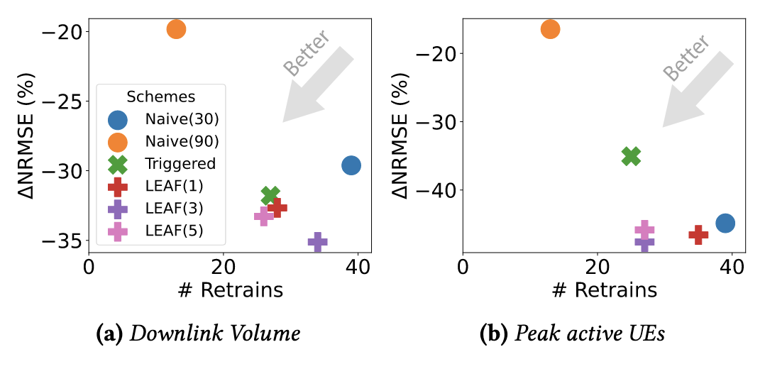
Mitigation effectiveness after involving multi-round feature groups.
Notes:
By adding the number of representative features, the effectiveness can be even better.
Only retrain once.
Overall, we achieve our design goals by these results.

Slide 24
Takeaways
Concept drift is a universal phenomenon in cellular network capacity forecasting, regardless of model family, training set size and training set period.
Naïve retraining is either ineffective, or effective but very costly. Models trained using the most recent data may not necessarily show less error over time.
It is viable to explain & mitigate concept drift across KPIs and models using LEAF (Local Error Approximation of Features), which can be applied to black-box models for regression-based prediction in general.
Notes:
To summarize, let me give you some takeaways
Summary of
Findings
I believe that LEAF can be used in other security applications as well.

Slide 25
Future work
Apply LEAF to other network management problems.
Extend LEAF to classification or to work without the requirements of ground truths.
Explore robustness of “ML for Networking” in general.
Notes:
Add this slide
Hide the comments
Future work, application
Robustness related

Slide 26

Questions?
Scan for Dataset
Shinan Liu, Francesco Bronzino, Paul Schmitt, Arjun Nitin Bhagoji, Nick Feamster, Hector Garcia Crespo, Timothy Coyle, Brian Ward

Slide 27
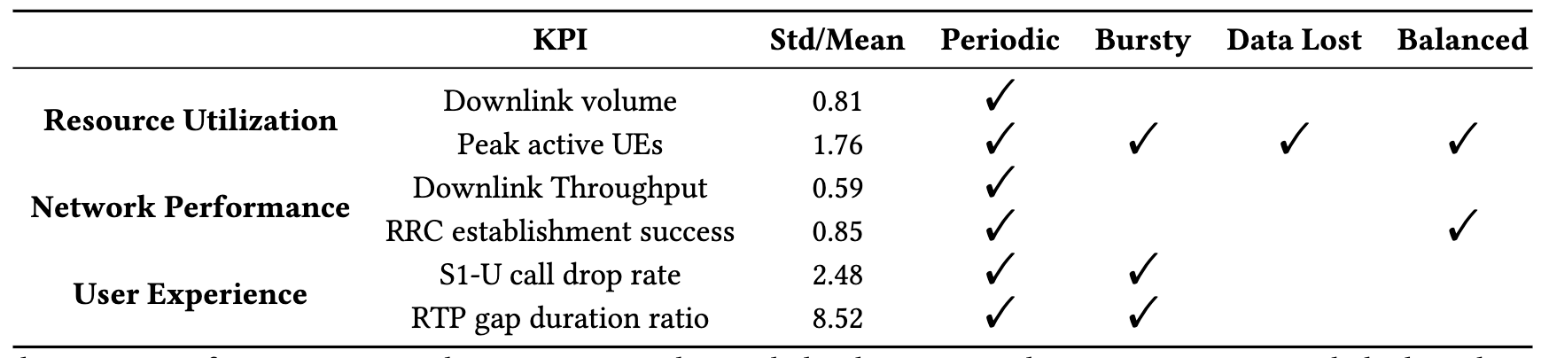
We investigate 6 Key Performance Indicators.
Notes:
We aim to predict the following KPIs that are most relevant for our task later: measurements of network performance (downlink throughput, RRC / Radio Resource Control establishment success), resource utilization (downlink data volume, peak number of active UEs / User Equipment), and user experience (S1-U / S1 User plane external interface call drop rate)
These KPIs exhibit a variety of statistical patterns and characteristics which, as we will see later can ultimately affect how models drift over time.

Slide 28
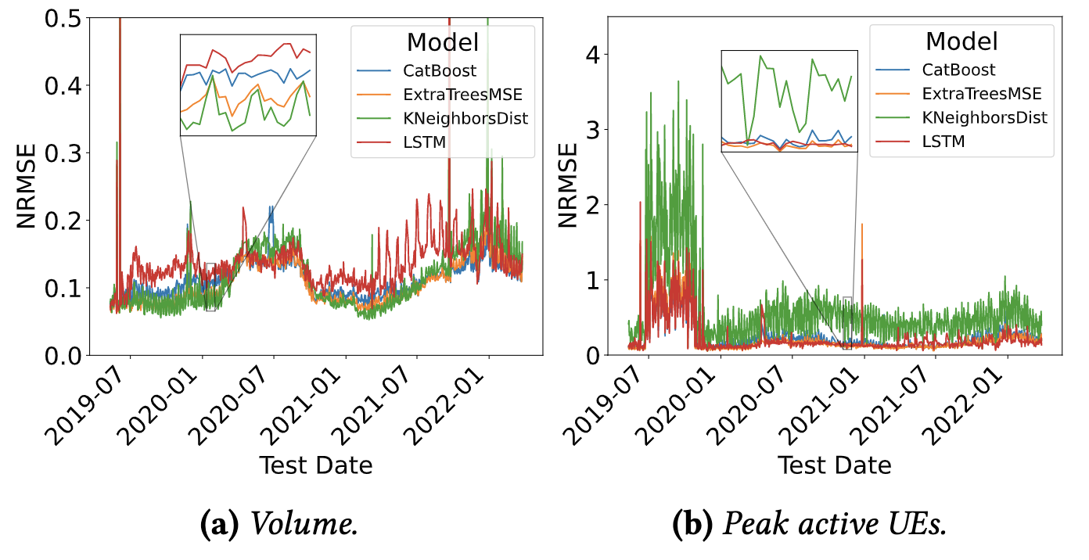
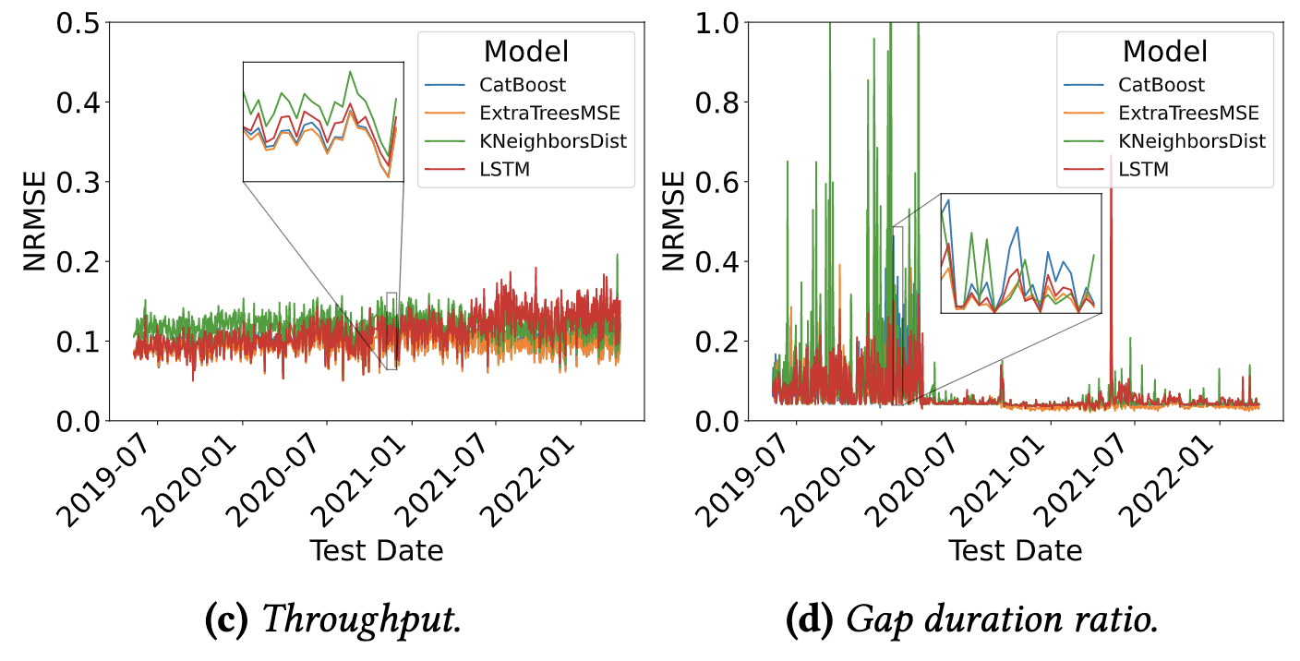
Different KPIs exhibit different drift patterns.
Notes:
The last insight we have is that different KPIs exhibit different drift patterns.
Let’s not look at the details and focus on the shape of them.
Overall, the drift patterns are quite unique for each KPI, and they vary in two aspects. First, deviations in NRMSE occur at different periods of time.
Second, Different KPIs are most effectively predicted using different models.

Slide 29
Contributions
Unique challenges to address drift in cellular networks:
Characterization
Diverse environment, dynamic signal interference, different morphology …
Explanation
Regression models for prediction
Mitigation
Lack of end-to-end solutions
Notes:
It is a significant operational challenge
Although concept drift is explored a lot in other domains, the networking domain does not have a thorough investigation in it.
Some characteristics of cellular networks make this question uniquely challenging.
For characterizations, cellular towers often have diverse environment, dynamic signal interference, different morphology
For explanation, although we see some recent developments of explanation techniques for drift in, for example malware detection, they are limited to classification problems. However, major tasks in cellular networks are based on regression models. Regression is the game for operational networks.
For mitigation, there’s a lack of an end-to-end solution to address drift as well.

Slide 30
LEAF is a ____
Data selection scheme for better model performance across domains.
Model explainer that attributes drift to features.
Drift mitigation approach that effectively reduce errors in online settings.
Drift handling pipeline which is cost-aware.

Slide 31
System design goals and challenges.
Effective
Low cost
Explainable
Notes:
So what do we want? Keep the effectiveness, and minimize the number of retrains needed.
No drift explanation method was designed for regression models. A common challenge in evaluating the performance of machine learning-based solutions is that only a subset of algorithms (e.g., linear or lo- gistic regression, KNeighbors, decision trees, decision rules) are interpretable [40]. Unfortunately, in practice, a wide va- riety of uninterpretable models are used (i.e., outsourced models such as OpenAI GPT-3 [12], or black-box models).
If you think about it, this is the way that operators do in real-world.
Naïve retraining has some drawbacks
When and where, which feature is the most responsible for concept drift.

Slide 32
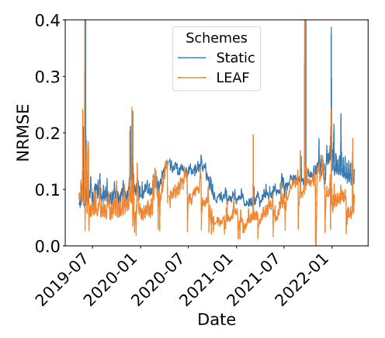
Mitigation effectiveness of LEAF vs. static
Default: use CatBoost to predict Downlink Volume.
Notes:
We show results for the static model and TRAO. Compared to the static model, we observe that the LEAF mitigation consistently improves model performance (in terms of NRMSE)throughout the duration of the experi- ment. We observe that mitigation promptly occurs once drift is detected. This is particularly evident for sudden changes in the NRMSE distribution (e.g., around January and April 2020). Throughout the time series, the NRMSE of TRAO for CatBoost never surpasses 0.125 (with the exception of spikes due to data errors) and goes as low as 0.04. This ensures a bounded error distribution and decreases the average error by 18.16%. We observe similar behavior for all models and KPIs.
To better understand the effectiveness of different miti- gation schemes, we study their relative average improve- ment. Figure b shows the CDF of errors for CatBoost across schemes and all eNodeBs on August 1, 2020. We observe that the 95% NRMSE of CatBoost is effectively reduced from 0.29 for the static to 0.14 for TRAO.
Other KPIs can be found in paper

Slide 33








Great minds behind this work.
Shinan Liu
Prof. Francesco Bronzino
Prof. Paul Schmitt
Dr. Arjun Nitin Bhagoji
Prof. Nick Feamster
Hector Garcia Crespo
Timothy Coyle
Brian Ward
Notes:
Mentors, advisor Nick, and Verizon WAIV team

